Slide 1
Project title: Social Feedback-Enhanced Argument Claim Extraction from News Headline
Name: Wei Chuen Sea

Slide 2
Aims of the project:
To extract argument claims from news headlines
Implement a social aspect to enhance argument claim extraction
To evaluate the method using suitable statistical techniques.

Slide 3
Dataset
Web scrapping from the Reddit news aggregation website
Used r/science subreddit
200 submissions along with their comments have been used
Notes:
currently, there are no news headline datasets with comments available,
Therefore, i scraped from reddit, which is a news aggregation website.
I have also used the science subreddit, which has heavy moderation, this would reduces the need of pre-processing
Which is usually required when using user generated data

Slide 4
Data labelling
headlines | labelled_argument
Lesbians, gays, bisexuals experience migraines at a rate 58% higher than heterosexual or "mostly straight" people. 1 in 6 adults will have migraine headaches in their lifetime, but among LGB people, that figure is 1 in 3. Researchers speculate that added stress and discrimination may be responsible. | Lesbians, gays, bisexuals experience migraines at a rate 58% higher than heterosexual or "mostly straight" people.
The prevalence of dementia in countries where more than one language is spoken is 50% lower than in those regions where the population uses only one language to communicate. Active bilingualism is an important predictor of delay in the onset of symptoms of mild cognitive impairment. | Active bilingualism is an important predictor of delay in the onset of symptoms of mild cognitive impairment.

Slide 5
Pre processing
Tokenisation
Stop words removal
Lemmatisation
headlines | headline_preprocessed
6% of adults hospitalized with COVID-19 in the US were healthcare workers. Among them, 36% were in nursing-related occupations. Approximately 28% of these patients were admitted to an ICU, 16% required invasive mechanical ventilation, and 4% died. | [['adult', 'hospitalized', 'covid', 'healthcare', 'worker', 'among', 'nursing', 'related', 'occupation', 'approximately', 'patient', 'admitted', 'icu', 'required', 'invasive', 'mechanical', 'ventilation', 'died']]

Slide 6
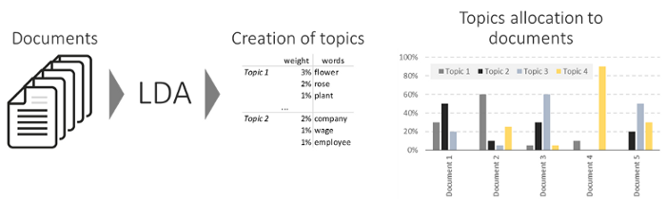
Latent Dirichlet Allocation (LDA)

Slide 7
Implementation of social feedback
headline | headline_preprocessed | headline_comment_preprocessed
Lesbians, gays, bisexuals experience migraines at a rate 58% higher than heterosexual or "mostly straight" people. 1 in 6 adults will have migraine headaches in their lifetime, but among LGB people, that figure is 1 in 3. Researchers speculate that added stress and discrimination may be responsible. | [['lesbian', 'gay', 'bisexual', 'experience', 'migraine', 'rate', 'higher', 'heterosexual', 'mostly', 'straight', 'people', 'adult', 'migraine', 'headache', 'lifetime', 'among', 'lgb', 'people', 'figure', 'researcher', 'speculate', 'added', 'stress', 'discrimination', 'may', 'responsible']] | [['lesbian', 'gay', 'bisexual', 'experience', 'migraine', 'rate', 'higher', 'heterosexual', 'mostly', 'straight', 'people', 'adult', 'migraine', 'headache', 'lifetime', 'among', 'lgb', 'people', 'figure', 'researcher', 'speculate', 'added', 'stress', 'discrimination', 'may', 'responsible', 'stress', 'experience', 'experience', 'experience', 'stress', 'stress', 'experience', 'migraine', 'migraine', 'higher', 'rate', 'migraine', 'migraine', 'discrimination', 'migraine', 'headache', 'stress', 'stress', 'migraine', 'migraine', 'stress', 'stress', 'lgb', 'stress', 'stress', 'stress', 'rate', 'heterosexual', 'migraine', 'migraine', 'migraine', 'migraine', 'migraine', 'migraine', 'stress', 'migraine']]

Slide 8
LDA for argument extraction
headlines | labelled_argument | headline_lda | social_aspect_lda
6% of adults hospitalised with COVID-19 in the US were healthcare workers. Among them, 36% were in nursing-related occupations. Approximately 28% of these patients were admitted to an ICU, 16% required invasive mechanical ventilation, and 4% died. | ['adult', 'hospitalized', 'covid', 'healthcare', 'worker'] | mechanical icu ventilation required related patient occupation nursing | healthcare hospitalised adult covid patient worker admitted died
Immune cell activation in severe COVID-19 resembles lupus. This may explain why some people infected with SARS-CoV-2 produce abundant antibodies against the virus, yet experience poor outcomes. | ['immune', 'cell', 'activation', 'severe', 'covid', 'resembles', 'lupus'] | produce sars people poor | covid lupus infected produce

Slide 9
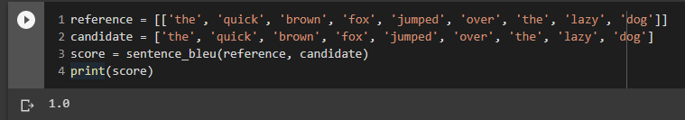
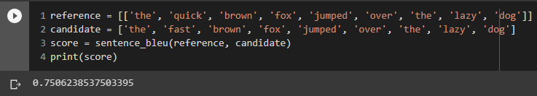
Bleu metric example

Slide 10
LDA results
top n words of LDA | Average_baseline_bleu_score | Average_social_aspect_bleu_score
n = half of headline + 7 | 0.66 | 0.63
n = half of headline + 5 | 0.67 | 0.63
n = half of headline + 3 | 0.66 | 0.63
n = half of headline | 0.66 | 0.65
n = half of headline - 3 | 0.65 | 0.63
n = half of headline - 5 | 0.65 | 0.63
n = half of headline - 7 | 0.66 | 0.65
n = half of headline - 10 | 0.60 | 0.60
n = half of headline - 11 | 0.57 | 0.56
n = half of headline - 12 | 0.53 | 0.53
n = half of headline - 13 | 0.48 | 0.49

Slide 11
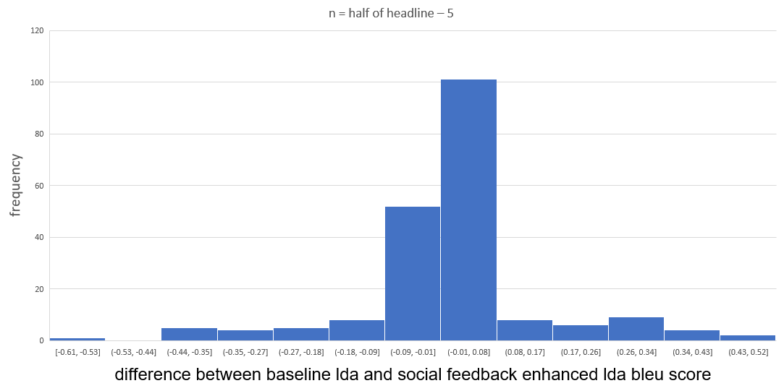
LDA results analysis

Slide 12
Headlines that social feedback enhanced method performed well
headlines | labelled_argument | headline_lda | social_aspect_lda | baseline_bleu_score | social_aspect_bleu_score
6% of adults hospitalised with COVID-19 in the US were healthcare workers. Among them, 36% were in nursing-related occupations. Approximately 28% of these patients were admitted to an ICU, 16% required invasive mechanical ventilation, and 4% died. | ['adult', 'hospitalized', 'covid', 'healthcare', 'worker'] | mechanical icu ventilation required related patient occupation nursing | healthcare hospitalised adult covid patient worker admitted died | 0 | 0.86
Immune cell activation in severe COVID-19 resembles lupus. This may explain why some people infected with SARS-CoV-2 produce abundant antibodies against the virus, yet experience poor outcomes. | ['immune', 'cell', 'activation', 'severe', 'covid', 'resembles', 'lupus'] | produce sars people poor | covid lupus infected produce | 0 | 0.53

Slide 13
Headlines that social feedback enhanced method performed poorly
headlines | labelled_argument | headline_lda | social_aspect_lda | baseline_bleu_score | social_aspect_bleu_score
For the first time scientists have made a discovery of hallucinogenic drug remains at the site of an early California cave painting. These drug remnants were discovered in the ceiling of Pinwheel Cave and could change scientists’ understanding of how the community used that space -- and the drugs. | ['first', 'time', 'scientist', 'made', 'discovery', 'hallucinogenic', 'drug', 'remains', 'site', 'early', 'california', 'cave', 'painting'] | drug scientist cave pinwheel hallucinogenic understanding time space site remnant remains california painting discovered | cave drug used time scientist pinwheel hallucinogenic community change remains understanding ceiling space site | 0.88 | 0.42
New research could help millions who suffer from 'ringing in the ears': Researchers show that combining sound and electrical stimulation of the tongue can significantly reduce tinnitus, commonly described as "ringing in the ears"; therapeutic effects can sustain for up to 12 months post-treatment | ['researcher', 'show', 'combining', 'sound', 'electrical', 'stimulation', 'tongue', 'significantly', 'reduce', 'tinnitus'] | ringing ear research tongue tinnitus therapeutic sustain suffer stimulation sound significantly show | tongue sound help tinnitus ringing research electrical stimulation month suffer combining ear | 0.82 | 0.44

Slide 14
Limitations
Restricted way of using social feedback
Restricted methods of argument extraction
Limited labelled dataset
Labelled argument is subjective to annotator

Slide 15
Future works
Social feedback
Pre processing
Argument extraction
Data

